Slide 1


Department of BES-I
COURSE: Data Structures
COURSE CODE: 24SC1203
Topic:
Name of the topic:
Singly Linked List
Session – 10

Slide 2



AIM OF THE SESSION
To familiarize students with the basic concept of Singly linked list
INSTRUCTIONAL OBJECTIVES
This Session is designed to:
Demonstrate The Singly linked list
Describe the types of Singly linked list.
List out the operations possible on the Singly linked list.
Describe each operation
List out the advantages and applications of SLL.
LEARNING OUTCOMES
At the end of this session, you should be able to:
Define Singly linked list
Describe two types of Singly linked list. And their operations
Summarize definition, types and operations of circular linked list and its applications

Slide 3
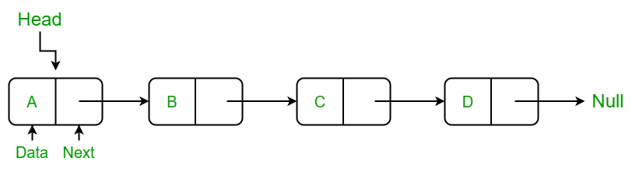
Singly Linked List
INTRODUCTION
A singly linked list is a linear data structure in which the elements are not stored in contiguous memory locations.
Each element is connected only to its next element using a pointer.
Every node points to its next node in the sequence and the last node points NULL.

Slide 4
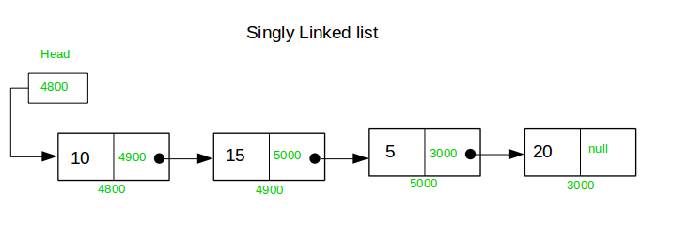
Example of Singly Linked list with 4 nodes

Slide 5
OPERATIONS ON SINGLY LINKED LIST
In a singly linked list, we can perform the following operations...
  Reverse
  sorting
  Merging

Slide 6
Setup the Singly Linked List
Before we implement those operations, first we need to setup empty list.
Perform the following steps to setup Empty SLL:.
Step 1 - Define a Node structure with two members/fields data and next
Step 2 - Define a Node pointer 'head' and set it to NULL.
Step 3 – Then perform the Operations one by one.
The node is defined (represented) as:
struct Node
{
int data;
struct Node * next;
};
struct Node *head=NULL;

Slide 7
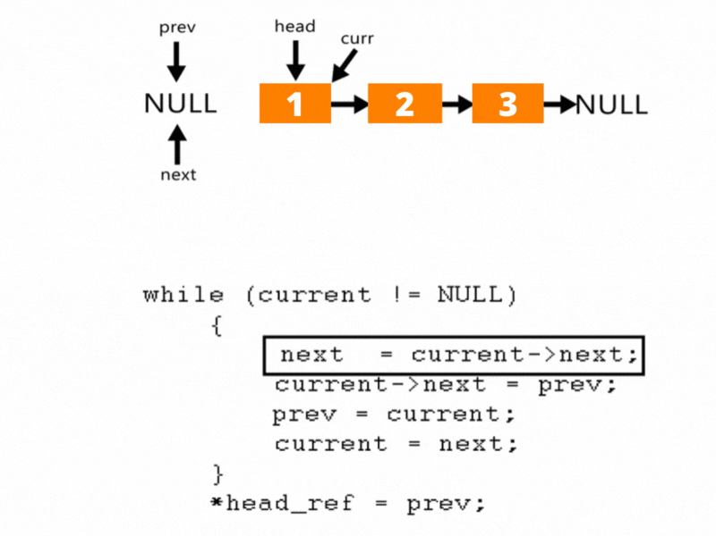
Reverse
Follow the steps below to solve the problem: Initialize three pointers prev as NULL, curr as head, and next as NULL. Iterate through the linked list. In a loop, do the following: Store the next node, next = curr -> next Update the next pointer of curr to prev, curr -> next = prev Update prev as curr and curr as next, prev = curr and curr = next

Slide 8
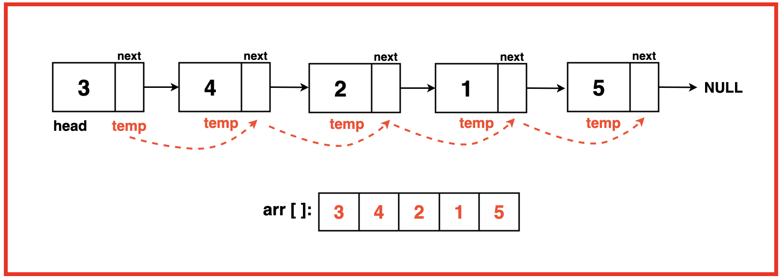
sorting
To apply Bubble Sort to a linked list, we need to traverse the list multiple times, comparing adjacent nodes and swapping their positions by adjusting their links if the current node’s data is greater than the next. During each pass, the largest unsorted element moves to its correct position at the end of the list. This process continues until no more swaps are needed, indicating that the list is sorted.

Slide 9
struct Node *bubbleSort(struct Node *head) {
int t;
struct node *t1,*t2;
For(t1=head;t1->next!=null;t1=t1->next)
{
For(t2=head;t2->next!=NULL;t2=t2->next)
{
if(t2->data>t2->next->data)
{
t=t2->data;
t2->data=t2->next->data;
t2->next->data=t;
}
}
}

Slide 10
Merging
Merging two linked lists can mean different operations depending on the context. Here are two common scenarios: 1. Merge Two Sorted Linked Lists If the linked lists are sorted, you can merge them into one sorted list. Here's the algorithm: Use two pointers, one for each list. Compare the current nodes of both lists. Append the smaller value to the merged list and move the pointer for that list forward. If one list is exhausted, append the remaining nodes of the other list.
2. Concatenate Two Linked Lists
If you simply want to append one linked list to another:
Traverse the first list to its end.
Point the last node of the first list to the head of the second list.

Slide 11
#include <stdio.h>
#include <stdlib.h>
typedef struct Node {
int data;
struct Node* next;
} Node;
// Function to create a new node
Node* createNode(int data) {
Node* newNode = (Node*)malloc(sizeof(Node));
newNode->data = data;
newNode->next = NULL;
return newNode;
}
// Merge two sorted linked lists
Node* mergeSortedLists(Node* list1, Node* list2) {
if (!list1) return list2;
if (!list2) return list1;
Node* mergedHead = NULL;
if (list1->data <= list2->data) {
mergedHead = list1;
mergedHead->next = mergeSortedLists(list1->next, list2);
} else {
mergedHead = list2;
mergedHead->next = mergeSortedLists(list1, list2->next);
}
return mergedHead;
}
// Function to print the linked list
void printList(Node* head) {
while (head) {
printf("%d -> ", head->data);
head = head->next;
}
printf("NULL\n");
}
/

Slide 12
THANK YOU
Team – Data Structures

